Slide 1
Climate Change A Human Health Perspective A Student Exploration of the Impacts of Climate Change on Human Health in the United States

Slide 2
Learning Objectives
- Describe the impacts of a changing climate on human health
- Discuss vulnerable populations
- Apply systems thinking to create a visual model of health implications
- Consider benefits of climate mitigation on human health
- Evaluate adaption strategies that are protective of human health

Slide 3
Engagement Activity (15-20 minutes)
Exploring Prior Knowledge
Share examples of climate change and effects on human health
Notes:
Draw a T chart with the left hand column- examples of climate change and right hand as human health effects
Ask students to name examples of climate change like increased air temp, precipitation, weather to asses their knowledge. Record all responses

Slide 4
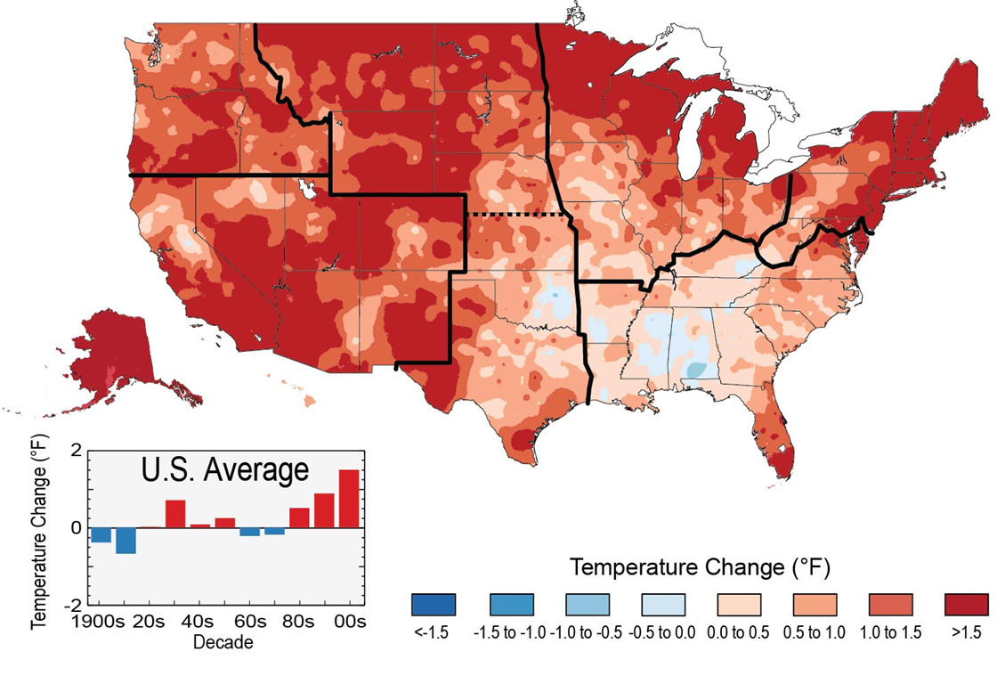
Examples
List the Impact(s) of a Warming Climate on Human Health.
Image credit: http://nca2014.globalchange.gov/highlights/report-findings/widespread-impacts
The colors on the map show temperature changes over the past 22 years (1991-2012) compared to the 1901-1960 average for the contiguous U.S., and to the 1951-1980 average for Alaska and Hawai'i. The bars on the graph show the average temperature changes by decade for 1901-2012 (relative to the 1901-1960 average). The far right bar (2000s decade) includes 2011 and 2012. The period from 2001 to 2012 was warmer than any previous decade in every region. (Figure source: NOAA NCDC / CICS-NC).
Notes:
Image credit: http://nca2014.globalchange.gov/highlights/report-findings/widespread-impacts
The colors on the map show temperature changes over the past 22 years (1991-2012) compared to the 1901-1960 average for the contiguous U.S., and to the 1951-1980 average for Alaska and Hawai'i. The bars on the graph show the average temperature changes by decade for 1901-2012 (relative to the 1901-1960 average). The far right bar (2000s decade) includes 2011 and 2012. The period from 2001 to 2012 was warmer than any previous decade in every region. (Figure source: NOAA NCDC / CICS-NC).

Slide 5
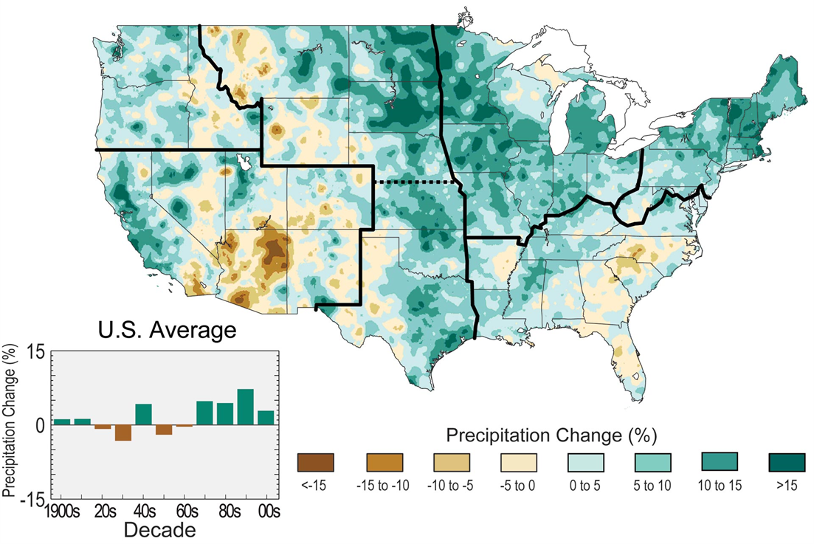
Examples
List the Impact(s) of a Wetter Climate on Human Health and of a Drier Climate on Human Health
The colors on the map show annual total precipitation changes for 1991-2012 compared to the 1901-1960 average, and show wetter conditions in most areas.
Notes:
Image Credit: http://nca2014.globalchange.gov/highlights/report-findings/our-changing-climate
The colors on the map show annual total precipitation changes for 1991-2012 compared to the 1901-1960 average, and show wetter conditions in most areas. The bars on the graph show average precipitation differences by decade for 1901-2012 (relative to the 1901-1960 average). The far right bar is for 2001-2012. (Figure source: NOAA NCDC / CICS-NC).

Slide 6
Engagement Activity-continued
Partner Activity
Discuss with a partner specific impacts of..
A warming climate on human health
A wetter climate on human health
A drier climate on human health
Notes:
Record their responses in the right hand column of the T chart aligned with relevant climatic changes in the left-hand column. Right or wrong answers don’t matter.

Slide 7
Engagement Part 2
Creating a Visual Model of Cause and Effect
Notes:
Summarize the conversation and tell students to construct a visual model to show the connection between a specific climate change like heavy participation and specific human health effect such as water contamination.

Slide 8
Questions
Flooding and Human Health
What is the specific climate change, also known as the climate driver, referenced by this data visual?
What is/are the environmental conditions that arise in response to this specific change? (create or exacerbate an environmental hazard)
What is the environmental hazard being examined? environmental hazard → negative health outcomes
What is are/ the health effects that might arise from exposure to the environmental hazard?
Health outcomes- impacts of the hazard on human health
Notes:
1st answer- precipitation
2nd answer- flooding
3rd answer- exposure to contaminated floodwaters
4th answer- water-borne illness

Slide 9
Flooding and Human Health
Some individuals and groups may be more vulnerable to water-borne infection as a result of floodwaters.
Notes:
This information we found in the past slide helped us construct a visual model of this cause and effect mechanism.

Slide 10
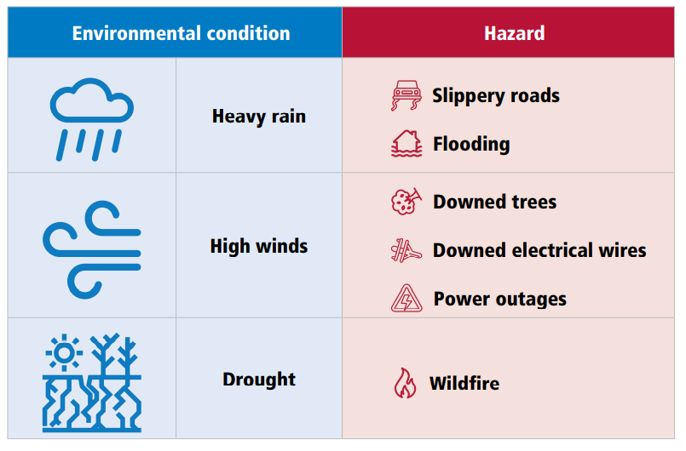
Notes:
Flooding can be both an environmental condition and hazard if high waters lead to injury or drowning.
Ask students- if they think of other human health hazards that might arise from flooding (like growth of mold and middew after water subsides)

Slide 11
Exploration (20-30 minutes)
Constructing a More Complex Visual Model
Read your assigned impact section
Group 1: Temperature-related impacts Group 5: Water-related impacts
Group 2: Air quality impacts Group 6: Impacts to food
Group 3: Impacts from extreme events Group 7: Impacts to mental health
Group 4: Vector-borne disease impacts
After reading, complete one or more rows of the graphic organizer
ID underlying environmental conditions that create the hazard, then climate drivers responsible for producing environmental conditions
Each group- ID one student to present model aloud to the class while group members contribute to the model by writing or placing their model components on the board
Notes:
Assign 3-4 students per chapter and distribute copies of reading to each group member
Tell students to complete the reading

Slide 12
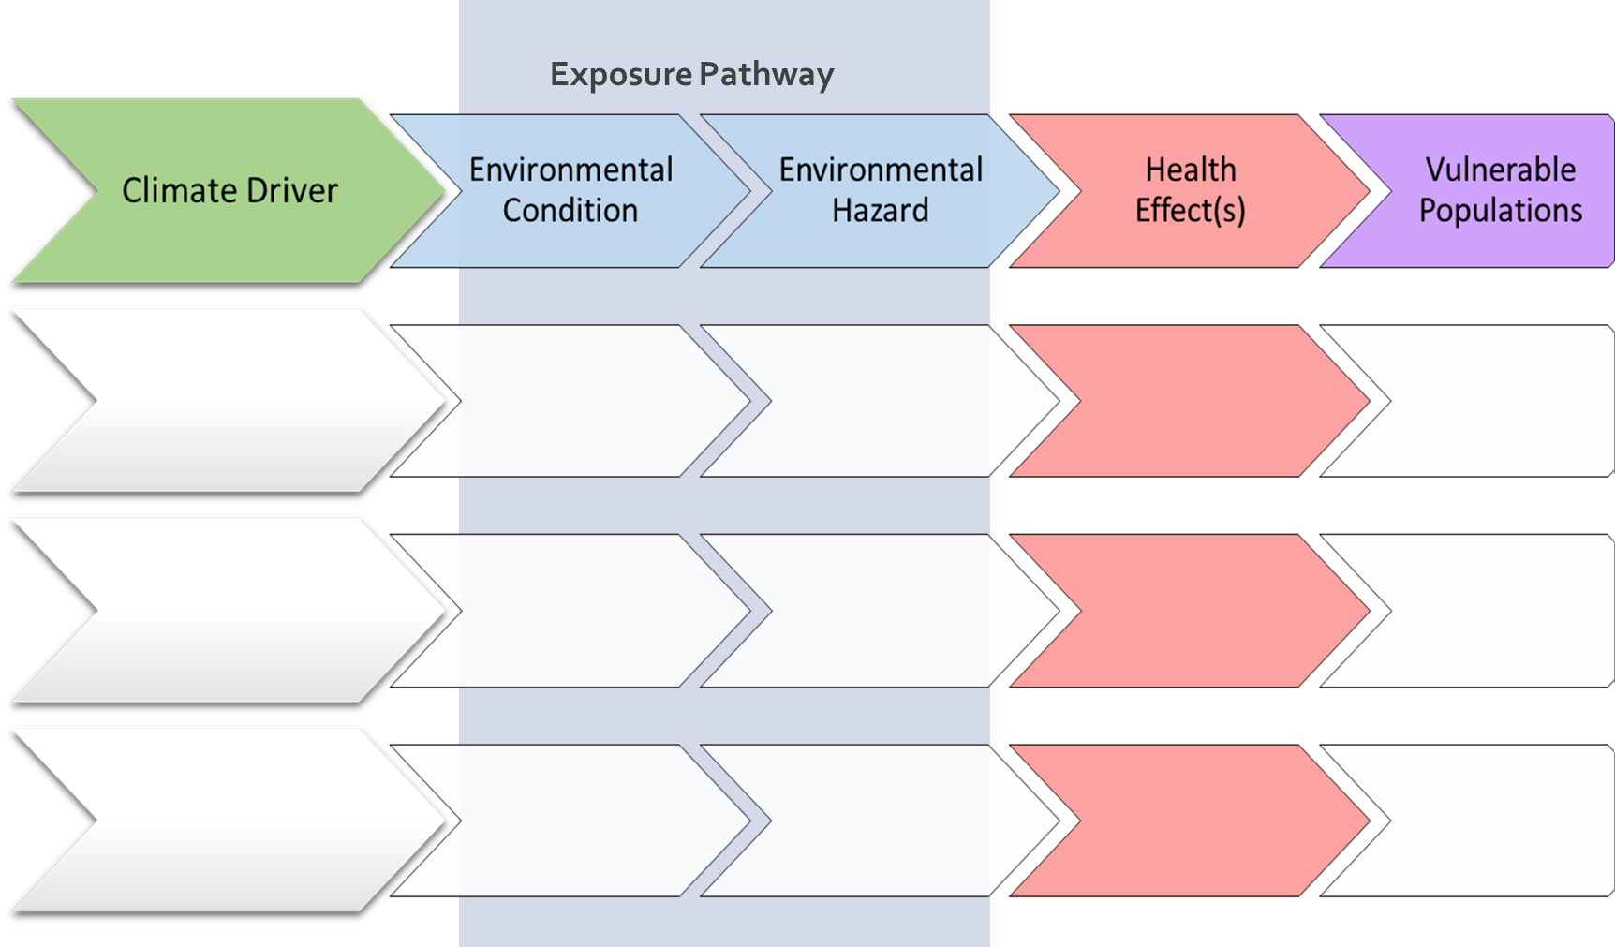

Slide 13
Explanation (20-30 minutes)
Present
Combine models to create a larger visual model to show the complexity of the climate and healthcare system
Each group- describe visual model and for each health outcome, mention vulnerable populations
What are some overlapping themes from the placement of cards/arrows?
Notes:
Students should write in their own words on the board or place sticky notes/cards in the appropriate location and connect words using a marker, tape, or chalk
Students note where one environmental condition like flooding influences other health outcomes by adding arrows
If a change in climate/ environment condition is already represented, students should use term already there and connect to new information.
Prompt students to consider terms that have already been placed on the board and make new connections using markers. Ex- drought will not only cause an increase in wildfires but also lead to crop failures resulting in shortage of food, higher food prices and increase in malnutrition.
Check if climate driver→ environmental condition→ environmental hazard→ health outcome sequence is logical and depicted before the next group goes.

Slide 14
Climate Driver
Exposure pathway
Health Outcomes
Increased AIR temperatures
Environmental Condition
Hazard
Decreased AIR temperatures
Changing Temperature
Increased WATER temperatures
Decreased WATER temperatures
Increased precipitation
Changing Precipitation
Decreased precipitation
Extreme weather events
Changing weather patterns
Changes in cloud cover, humidity, winds
Notes:
Students can notice- complex interconnected nature of our environment and its impact on human health
Need to simplify to better understand the individual parts of the system and their connections to each other

Slide 15
Questions about systems
Systems Introduction
Is the climate change-human health system depicted here a simple or complex system?
Is the climate change and human health system a physical system? Chemical system? Biological system?
Are there any smaller sub systems within the climate-health system?
What is the value of a systems approach to understanding the impact of climate on human health (ex- how does knowing about the bigger system help with the study of a smaller system)?
Notes:
1st question- complex system- one environmental condition leads to multiple hazards and health outcomes; multiple climate drivers interact to produce an environmental condition
2nd question- earth’s processes and its living inhabitants are systems within systems. The climate change and huan health system is composed of physical, chemical and biological systems that interact with each other and influence human health.
3rd question- yes the hydrosphere represents a system, the atmosphere represets a system, biosphere represents a system. All together systems make up the larger climate and health system. Human body is also a system and susceptibility can be influenced by factors like age, genetic make-up and socio-economic status.
4th question- helps id potential variables/influences on the system, if not aware of larger system, might reach erroneous conclusions or encounter unintended consequences
Can identify how communities like schools and the public health system will need to adapt to protect public health in response to changing changing climate.

Slide 16
Climate Driver
Exposure pathway
Health Outcomes
Increased AIR temperatures
Environmental Condition
Hazard
Decreased AIR temperatures
Changing Temperature
Increased WATER temperatures
Increased mold
Asthma & Allergies
Decreased WATER temperatures
High waters
Water-related infection
Increased precipitation
Flooding
Increase in nutrient runoff
Changing Precipitation
Drowning & Injury
Decreased precipitation
Disruptions to infrastructure
Food-related infection
Contaminated water
Extreme weather events
Stress-related disorders
Changing weather patterns
Changes in cloud cover, humidity, winds
Notes:
Students can notice- complex interconnected nature of our environment and its impact on human health
Need to simplify to better understand the individual parts of the system and their connections to each other

Slide 17
Questions
How Scientists Study the Climate and Health System
Why do you think scientists study one part of a bigger system (ex- incidence of malaria in areas of drought)?
What are the challenges for a scientist trying to study a smaller part of a bigger system? Consider parts of a system and its boundaries.
Notes:
1st question- to make it easier; too much to look at if study everything (like weather patterns, length of time, occurrence, quality of water supplies, etc). Complex systems therefore need to be simplified like on a cause and effect level pr experimentation level.
2nd question- defining boundaries of systems, identifying and controlling for variables, keeping track of what goes in leaves the system, identifying actions and reactions.

Slide 18
Conclusion
Climate and health system is complex
Important to study the system to understand how climate impacts human health
Scientists and policymakers also need to consider other systems connected to the system they’re interested in when advocating for strategies that protect human health

Slide 19
Elaboration
Greenhouse gas emissions from human activities drive the climate changes discussed
Mitigation strategies: Actions we can take to reduce the severity of climate change by reducing greenhouse gas emissions.
Adaption strategies: Actions we can take to reduce our risk/vulnerability to climate impacts.
Consider health co-benefits
Implementing renewable energy technologies means fewer greenhouse gas emissions and also reduced emissions of particulate matter, thus improving air quality AND overall improved cardiopulmonary health.
Note: these health co-benefits may have an even bigger impact to already vulnerable populations (e.g. those with asthma).
Notes:
Through these mitigation and adaption changes in activities and practices, we could limit the mitigation of changes to the planet’s climate and the negative impacts to human health. It’s possible that some mitigation strategies could exacerbate human stressors or introduce unanticipated potential for human harm, but many strategies provide co-benefits, reducing the negative effects of climate change and reducing illness or death. One example explains that shifting dietary intake to more environmentally-friendly and healthy options could reduce greenhouse gas emissions and land and water stress, while improving health

Slide 20
Task
How Climate Mitigation Will Impact Health Outcomes
Identify personal (individual) and societal (collective) solutions that could be advanced to:
Prevent negative health outcomes from occurring in a changing climate
Promote preparedness/adaption so that the negative health outcomes are less severe or occur to a lesser extent than without intervention
Investigate local adaption strategies either being planned or implemented to address health outcomes
Evaluate pros and cons of implementation and share strategies
Notes:
A list of possible adaptation strategies is included for each chapter in the Toolkit Answer Key (starting on page14).

Slide 21
Activity- Evaluation
Evaluating an Adaptation Strategy: Option 1
Write a paragraph for your assigned chapter of the 2016 Climate and Health Assessment that describes relevant health co-benefits of climate mitigation efforts and describes adaptation strategies that could be implemented to protect human health in light of climate change.
Notes:
Students could further extend their learning by either working to implement their resilience project in their school or community (if applicable) or by advocating for their adaptation strategy or resilience building project through civic engagement with relevant policymakers (students could partner with a U.S. Government/Civics class).
Another avenue is to deliberately connect what students learned about climate change and human health to environmental justice, racism, and the health disparities that marginalized communities in the state, community or school district face due to climate change.

Slide 22
Activity- Evaluation
Evaluating an Adaptation Strategy: Option 2
Thoroughly evaluate at least one adaptation strategy (solution) we identified during the elaboration activity from an economic, social (including vulnerable populations) and environmental perspective and present your analysis to the class (in writing or as in-class presentation that could include a poster, brochure, infographic, etc.)
Notes:
This could evaluate a local solution to a health outcome in assigned chapter. Or students can write a letter to the editor of a local paper or policymaker highlighting how their community should prepare for human health outcomes related to their chapter.
Students could further extend their learning by either working to implement their resilience project in their school or community (if applicable) or by advocating for their adaptation strategy or resilience building project through civic engagement with relevant policymakers (students could partner with a U.S. Government/Civics class).
Another avenue is to deliberately connect what students learned about climate change and human health to environmental justice, racism, and the health disparities that marginalized communities in the state, community or school district face due to climate change.

Slide 23
Activity- Evaluation
Evaluating an Adaptation Strategy: Option 3
Design a solution to combat a specific health outcome that is relevant to your local community, state or region of the country.
(in writing or with a drawing/diagram or model)
Present to the class and state the specific problem you are trying to solve and clearly describe your solution.
Notes:
Students could further extend their learning by either working to implement their resilience project in their school or community (if applicable) or by advocating for their adaptation strategy or resilience building project through civic engagement with relevant policymakers (students could partner with a U.S. Government/Civics class).
Another avenue is to deliberately connect what students learned about climate change and human health to environmental justice, racism, and the health disparities that marginalized communities in the state, community or school district face due to climate change.

Slide 24
Activity- Evaluation
Evaluating an Adaptation Strategy: Option 4
Develop a resilience building project (climate adaptation plan) to address a specific climate threat (e.g. flooding) that is relevant to your school, community, state or region.
Notes:
Students could further extend their learning by either working to implement their resilience project in their school or community (if applicable) or by advocating for their adaptation strategy or resilience building project through civic engagement with relevant policymakers (students could partner with a U.S. Government/Civics class).
Another avenue is to deliberately connect what students learned about climate change and human health to environmental justice, racism, and the health disparities that marginalized communities in the state, community or school district face due to climate change.

Slide 25
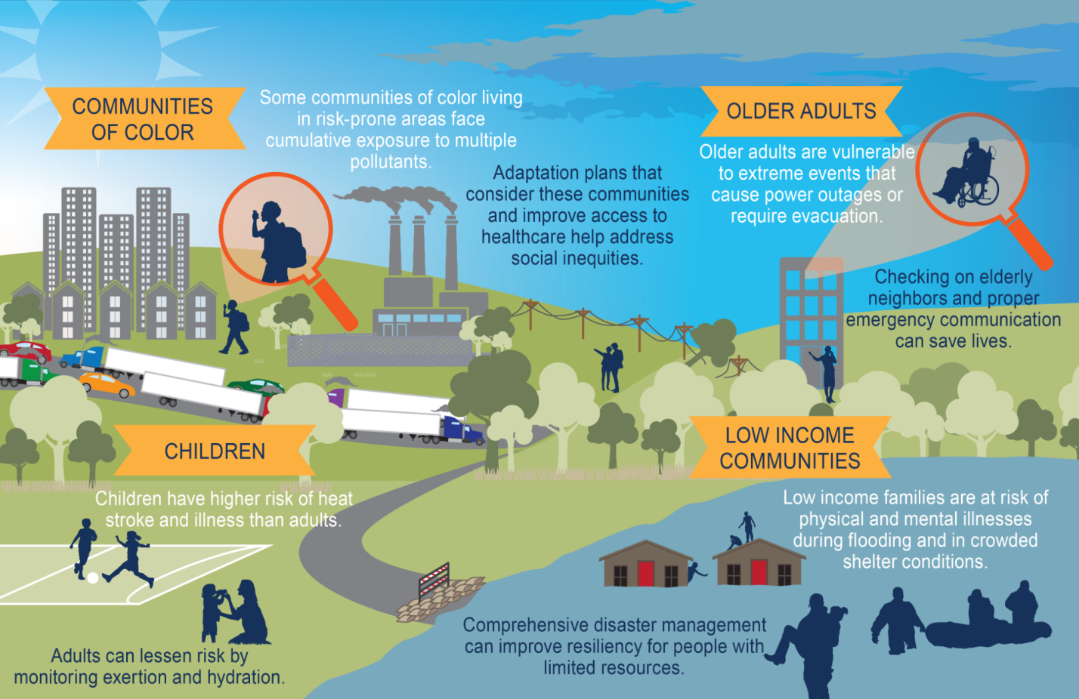
Vulnerable Populations
Source: Fourth National Climate Assessment’s Figure 14.2 “Vulnerable Populations, 2018”
Notes:
Optional extend slide: vulnerable populations
While climate change impacts all living things on the globe, some populations and communities are more climate-sensitive.
Children
Breathe more air and drink more water per body weight than adults
More susceptible to heat-related illness, dehydration ,or diarrheal illness
Older Adults
Low immunity
Pre-existing conditions
Limited mobility
Communities of Color
Structural racism
Language barriers
Low-Income Communities
Proximity to sources of air pollution
Food and water insecurity
Other groups that are particularly vulnerable to heat
Outdoor workers/indoor w/o ventilation or AC
Student athletes
Rural native or indigenous populations
Disabled people
People without access to AC
Those with pre-existing medical or health conditions
The homeless population
Unsurprisingly many of these same populations experience many other health inequities and have disparate health outcomes, and live in lower resourced communities.

Slide 26
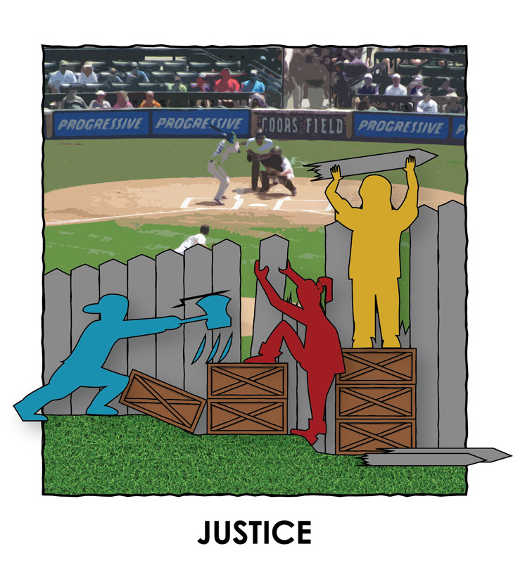
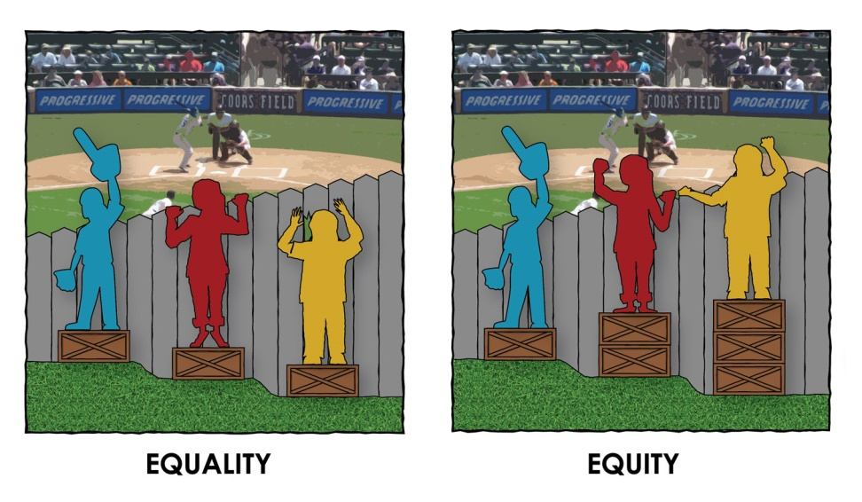
Extend
Equity and Justice
Source: Cultural Organizing
Notes:
Optional extend slide: Equity and Justice
First, let’s define health equity, which is that everyone has the opportunity to attain optimal levels of health. Advancing health equity recognizes the varying factors that influence health, such as housing, income, education and neighborhood. It requires that we value all people equally and that we optimize the conditions in which people are born, grow, live, work, learn and age.
Racial Equity, which is central to health equity, is what will be achieved when race and ethnicity does not influence how one fares in society.
So here’s a graphic that you’ve probably seen in some form.
Where equality means giving everyone the same thing, you can see that disparities still exist in who is able to see over the fence. Equity involves providing resources according to need,
Justice takes it a step further and includes the confrontation of power, the redistribution of resources, and the systemic transformation necessary for real change. Justice requires urgent fundamental changes that reposition communities of color in relation to power and resources, which includes being able to challenge and shape the many institutions that determine a community’s conditions.

Slide 27
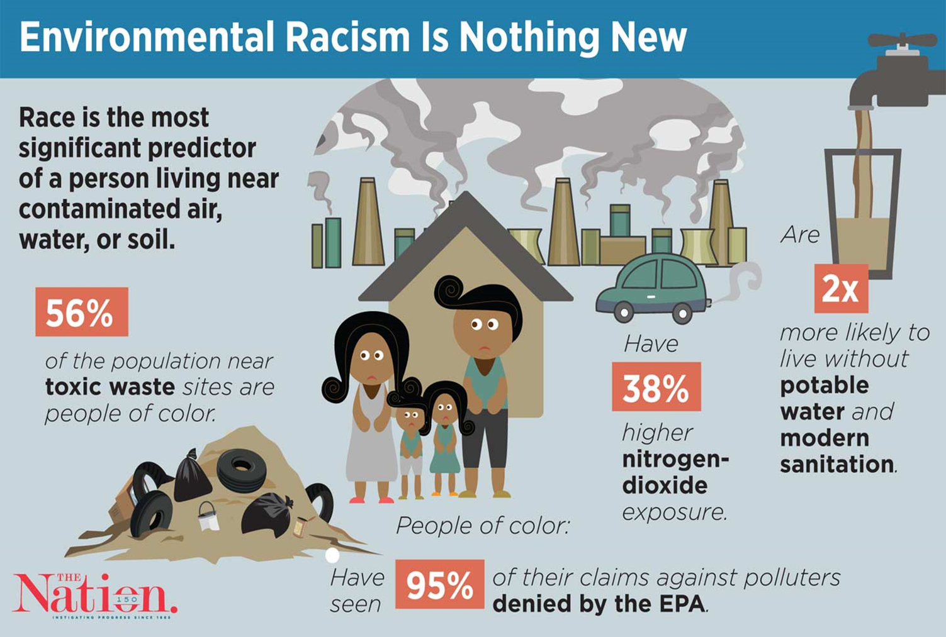
Notes:
Optional extend slide: Environmental racism
People in low income communities and communities of color generally experience greater burdens from preexisting health conditions which increase susceptibility to climate-related health threats. These communities are often historically disenfranchised, lacking the political and economic power and voice to ensure that decision makers take their perspectives, needs, and ideas fully into account. This lack of power contributes to health inequalities and constrains the ability of low-income communities and communities of color from building climate resilience and to contributing fully to climate change solutions.
Systemic racism: Impacts of climate change aren’t equally distributed among people. Race is the number one indicator for the placement of toxic facilities in this country. Making air pollution an issue where low- income communities and people of color receive disproportionate share of toxic air releases.

Slide 28
Extend
Historical Background of Environmental Racism
Environmental racism covers areas like air pollution, food inequality, proximity to hazards, vulnerability to disasters, access to quality and affordable healthcare, access to drinking water
Warren County, NC- small, poor predominantly African American community. State government planned to dump 6,000 truckloads of soil laced with toxic PCBs, which could leak into their drinking water supply
Flint, Michigan- failed to properly treat its water system which led to a mass lead poisoning from 2014-2015 in mostly low-income communities of color.
Notes:
Option extend slide: historical background of environmental racism
These are two of the examples from the longer list in the toolkit, feel free to switch them out with any others that are more relevant to your area!

